Slide 2
Unit 2: System Simulation (8 hrs)
2.1 Monte Carlo method
2.1.1 Problems regarding Monte Carlo method
2.2 Comparison of simulation and analytic solution
2.3 System simulation and its types
2.4 Real time simulation
2.5 Lag models (Distributed lag model, Cobweb model)
2.6 Queuing system and its characteristics and notation
2.7 Single server queuing model
2.7.1 Arrival routine
2.7.2 Departure routine
2.7.3 Performance measure of SSQM
2.8 Time advance mechanism (Next event oriented and fixed increment oriented)

Slide 3
Queuing System
A queuing system (or queueing model) is a mathematical model used to study waiting lines or queues.
It helps analyze situations where resources (like servers, machines, or people) provide services to arriving customers (humans, jobs, packets, etc.) over time.
The objective in the analysis of queuing situations is to balance the waiting and idle time so as to keep the total cost at minimum.

Slide 4
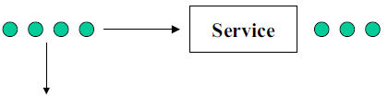
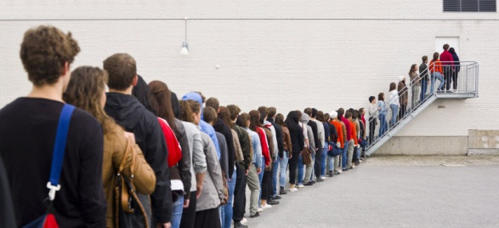
Queuing System
Customer arrivals
Departure of served customers
Departure of impatient customers

Slide 5
Queuing System
At its core, a queuing system involves:
Arrivals: Entities (customers, packets, tasks) entering the system to receive service.
Service Mechanism: One or more servers that process or serve the arriving entities.
Queue: A waiting line where entities wait if all servers are busy.
Departure: Entities leaving the system after service is completed.

Slide 6
Queuing System
Using Queuing models to
Describe the behavior of queuing systems
Evaluate the system performance.
Queue
Server
Queuing System
Server System

Slide 7
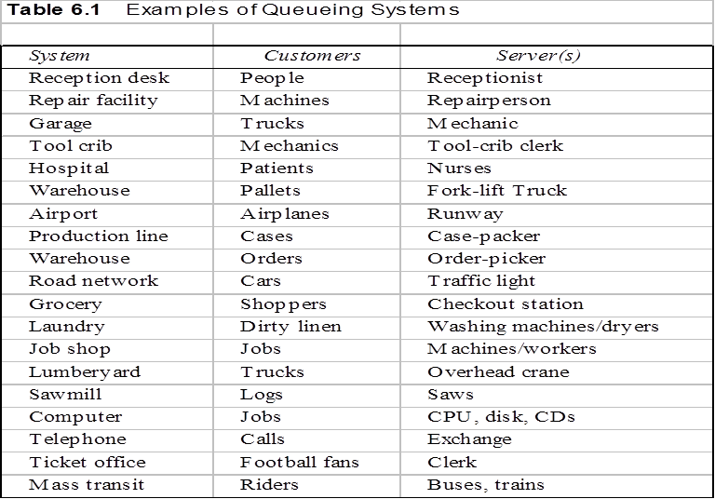
Queuing System

Slide 8
Queuing System Characteristics
A queuing system can be described and analyzed based on several key characteristics that define how entities arrive, wait, get served, and leave the system.
Arrival Process
Service Mechanism
Number of Servers
Queue Discipline (Service Order)
System Capacity
Population Source
Traffic Intensity (ρ)
Customer Behavior

Slide 9
Queuing System Characteristics
Arrival process:
Describes how and when customers arrive.
Interarrival Time: Time between successive arrivals.
Arrival Pattern: Random (usually Poisson) or deterministic.
Rate (λ): Average number of arrivals per time unit.
Example: Customers arriving at a bank every 3 minutes (λ = 20/hour).

Slide 10
Queuing System Characteristics
Service mechanism:
Describes how customers are served.
Service Time: Time taken to serve a customer.
Service Distribution: Exponential, constant, or general.
Service Rate (μ): Average number of customers served per unit time.
Example: ATM takes on average 2 minutes per user (μ = 30/hour).

Slide 11
Queuing System Characteristics
Number of servers (service channels):
Defines how many service channels are available:
Single server (e.g., one checkout counter)
Multiple servers (e.g., multiple call center agents)

Slide 12

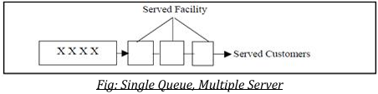
Queuing System Characteristics
Number of servers (service channels):
Arrangement of Service Facilities In Series:

Slide 13
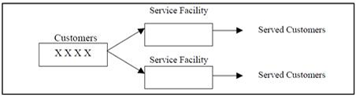
Queuing System Characteristics
Number of servers (service channels):
Arrangement of Service Facilities In Parallel:

Slide 14
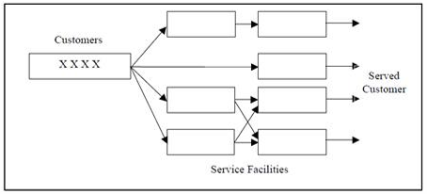
Queuing System Characteristics
Number of servers (service channels):
Arrangement of Mixed Service facilities:

Slide 15
Queuing System Characteristics
Queue discipline:
The order in which entities are served.
FIFO (First-In, First-Out) – Most common
LIFO (Last-In, First-Out) – Stack behavior
SIRO (Service in Random Order)
Priority Queue – Higher-priority customers served first
Example: Emergency rooms may use a priority-based queue.

Slide 16
Queuing System Characteristics
System capacity:
Maximum number of customers in the system (queue + service)
Finite: Limited space in the queue (e.g., parking lot, cinema hall).
Infinite: No upper bound on the number of waiting customers.
Example: A clinic may only allow 20 people in the waiting area.

Slide 17
Queuing System Characteristics
Population size:
The source of arriving customers.
Finite: The total number of potential customers is limited.
Infinite: Number of potential customers is so large it is treated as infinite.
Example: Repair shop with 10 machines (finite), or walk-in customers in a shop (infinite).

Slide 18

Queuing System Characteristics
Traffic Intensity (ρ)
Defined as:
ρ = $\frac{\text{λ}}{\text{μ}}$
Indicates how busy the system is.
If ρ<1: The System is stable.
If ρ≥1: the Queue will grow indefinitely.

Slide 19
Queuing System Characteristics
Customer Behavior
Balking: Customers leave upon seeing a long queue.
Reneging: Customers leave after waiting too long.
Jockeying: Customers switch between queues.

Slide 20
Queuing System Notation
Common Notation: Kendall’s Notation
A common format to describe a queuing system: A/S/c Where:
A: Arrival time distribution (e.g., M = Markovian or exponential)
S: Service time distribution
c: Number of servers
Example:
M/M/1: Exponential inter-arrival and service times, 1 server.
M/D/2: Exponential arrivals, deterministic service, 2 servers.

Slide 21
Performance Measures
Average number in system (L)
Average number in queue (Lq)
Average time in system (W)
Average time in queue (Wq)
Utilization (ρ): Percentage of time server is busy.

Slide 22
Single Server Queuing Model
A Single Server Queueing Model, commonly referred to as M/M/1, is the simplest and most fundamental model in queueing theory.
It represents systems where entities (like customers, jobs, or packets) arrive at a service point, wait in a queue if the server is busy, and are served one at a time by a single server.
Queue
Server
Queuing System
Server System

Slide 23
Assumptions of the M/M/1 Model
Arrival process is Poisson with rate λ (lambda).
Service times are exponentially distributed with rate μ (mu).
There is a single server.
The server is idle and in an empty state at the beginning.
First-Come, First-Served (FCFS) discipline.
The system has infinite capacity (no limit to queue length).
Customers never leave the queue (no balking or reneging).

Slide 24
Key Performance Metrics
Let:
λ = average arrival rate (customers per unit time)
μ = average service rate (customers served per unit time)
ρ = λ / μ = traffic intensity (should be < 1 for system to be stable)

Slide 25
Key Performance Metrics
Metric | Formula | Description
L | λ / (μ - λ) = ρ / (1 – ρ) | Average number of customers in the system
Lq | λ² / (μ(μ - λ)) = ρ² / (1 – ρ) | Average number of customers in the queue
W | 1 / (μ - λ) | Average time a customer spends in system
Wq | λ / (μ(μ - λ)) = W * ρ | Average waiting time in queue
P₀ | 1 - ρ | Probability that there are no customers in system
Pn | (1 - ρ) * ρ^n | Probability of n customers in the system

Slide 26
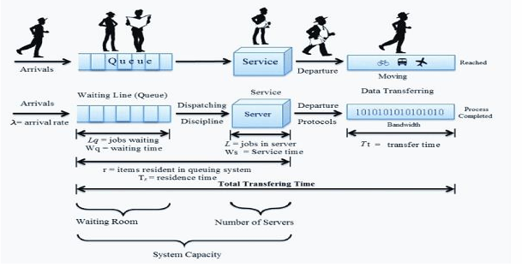
Key Performance Metrics

Slide 27
Example Scenario
Imagine a coffee shop with:
One barista (server)
Customers arriving every 3 minutes (λ = 20/hour)
Barista can serve one customer every 2 minutes (μ = 30/hour)
Then:
ρ = 20/30 = 0.67 → system is stable
L = 20 / (30 - 20) = 2 → average of 2 people in system
Lq = 20² / (30 * 10) = 1.33 → average of 1.33 people in queue

Slide 28
M/M/1 Queue Model Example
Given:
Arrival rate (λ) = 6 customers/hour
Service rate (μ) = 8 customers/hour
This means:
On average, 6 people arrive per hour.
A single server can handle 8 people per hour.

Slide 29
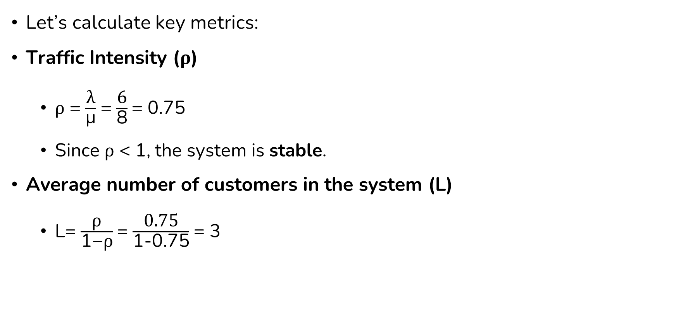
M/M/1 Queue Model Example
Let’s calculate key metrics:
Traffic Intensity (ρ)
ρ = $\frac{\text{λ}}{\text{μ}}$ = $\frac{\text{6}}{\text{8}}$= 0.75
Since ρ < 1, the system is stable.
Average number of customers in the system (L)
L= $\frac{\text{ρ}}{\text{1−}\text{ρ}}$= $\frac{\text{0.75}}{\text{1−0.75}}$= 3

Slide 30
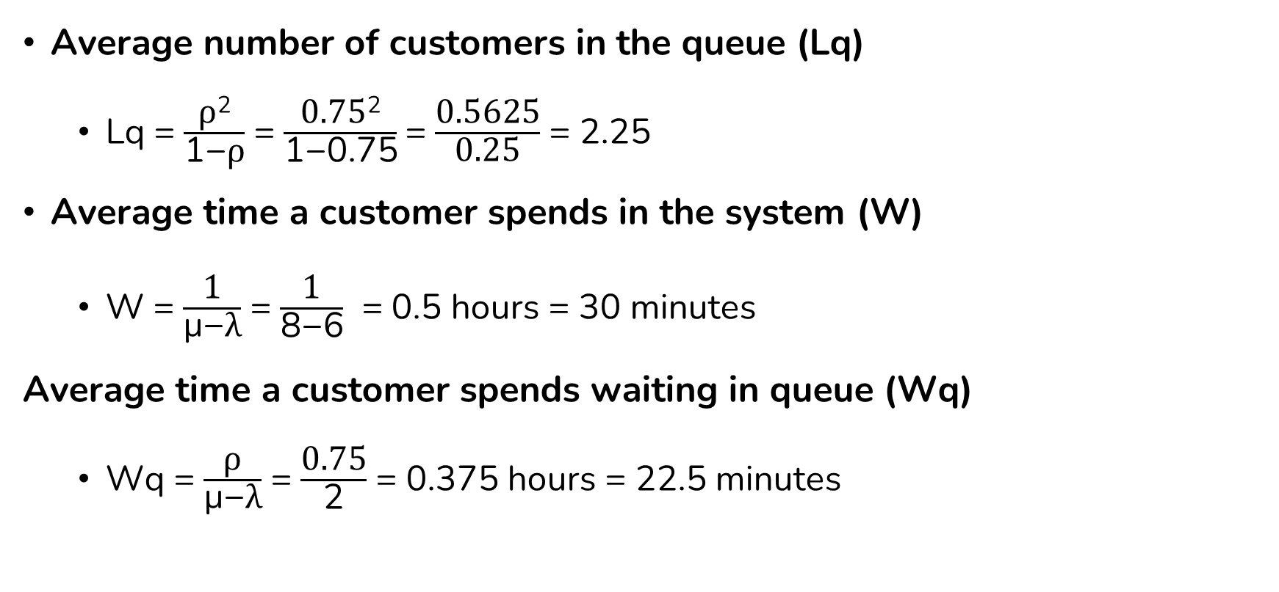
M/M/1 Queue Model Example
Average number of customers in the queue (Lq)
Lq = $\frac{\text{ρ}\text{2}}{\text{1−}\text{ρ}}$ = $\frac{\text{0.75}\text{2}}{\text{1}\text{−0.75}}$= $\frac{\text{0.5625}}{\text{0.25}}$ = 2.25
Average time a customer spends in the system (W)
W = $\frac{\text{1}}{\text{μ}\text{−}\text{λ}}$ = $\frac{\text{1}}{\text{8−6}}$ = 0.5 hours = 30 minutes
Average time a customer spends waiting in queue (Wq)
Wq = $\frac{\text{ρ}}{\text{μ}\text{−}\text{λ}}$ = $\frac{\text{0.75}}{\text{2}}$ = 0.375 hours = 22.5 minutes

Slide 31
End of Lecture 7

Slide 32
Continuous System

